Slide 1
Harmonizing Bioethics
--Global Ways in Integrating People and Values
(ISBN 978-3-643-91360-9)
A book published by the former president of
ISCB(2006-2010): Prof. Michael Cheng-tek Tai.Ph.D.
Publisher: Lit Verag Berlin-Munster-Wien-Zurich-London
(http://www.lit-verlag.ch)
Foreword by Hans Martin Sass.
Book Review by Dr.Tzuyioshi Awaya, published in Eubios Journal of Asian and International Bioethics (EJAIB) Vol. 31 (7) October 2021.

Slide 2
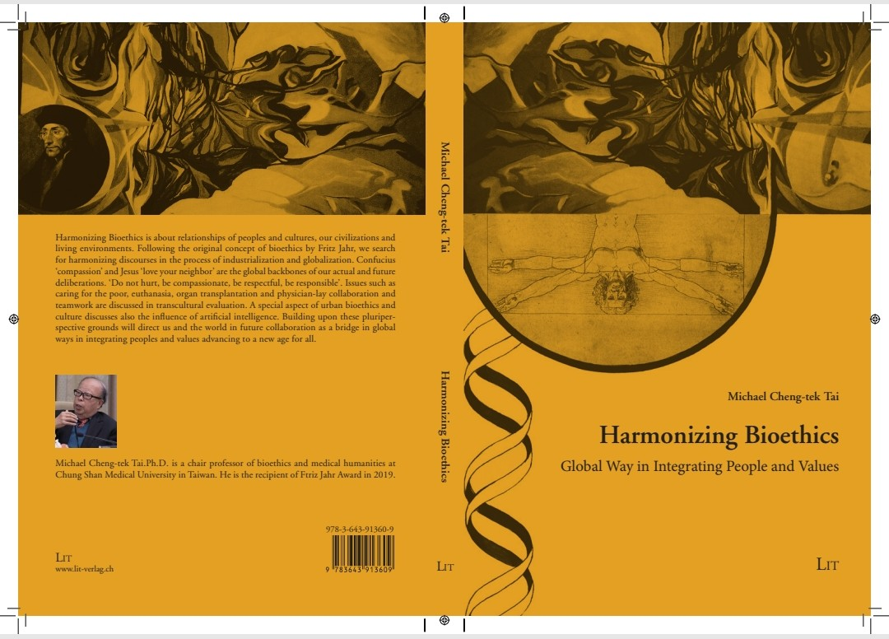

Slide 3
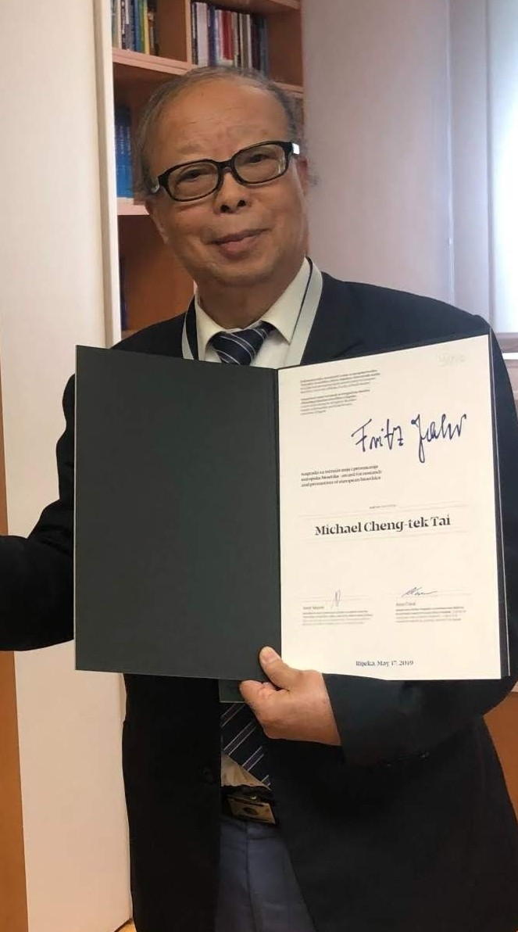

Slide 4
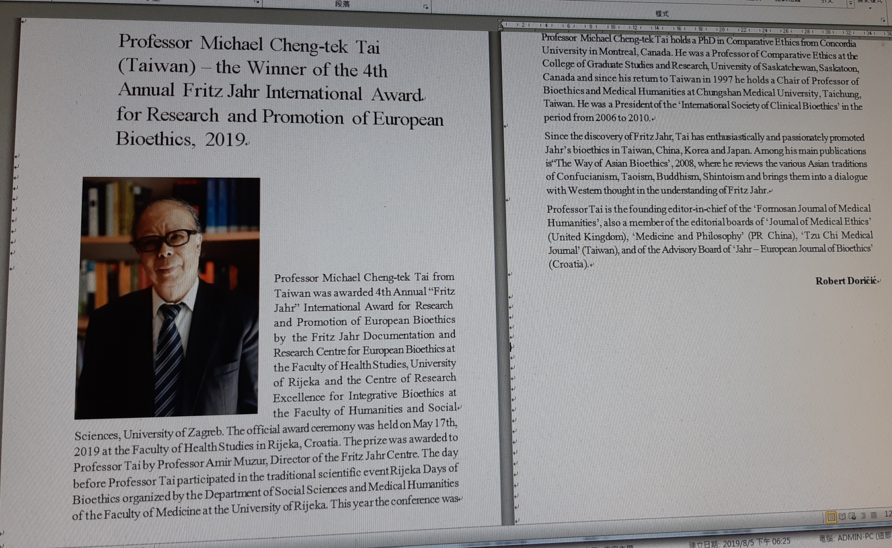
The announcement of 4th Fritz Jahr International Award recipient:

Slide 5
Harmonizing Bioethics is about relationship of peoples and cultures, our civilization and living environments. Following the original concept of bioethics by Fritz Jahr, the book searches harmonizing discourses in integrative bioethics, issues such as caring for the poor, urban bioethics, the influence of artificial intelligence, euthanasia, organ transplantation and physician-lay collaboration and teamwork ….etc are discussed in transcultural evaluation. Building upon these pluriperspective grounds the author argues that the integrative bioethics will direct us and the world to collaborate in the future as a bridge in integrating peoples and values advancing to a new age for all.

Slide 6
“ The question of global bioethics has been debated
by bioethics scholars. Regardless of cultural differences
within the world, we can confidently say compassion or love has
been the common human nature that every culture advocates;
therefore, global bioethics cannot be conveniently rejected. The
debate and discussion of an integrated bioethics, however must
be encouraged in order to excel and deepen the understanding
of globally integrated bioethics and also to promote cultural
dialogue.” (quoted from Michael Tai’s article)

Slide 7
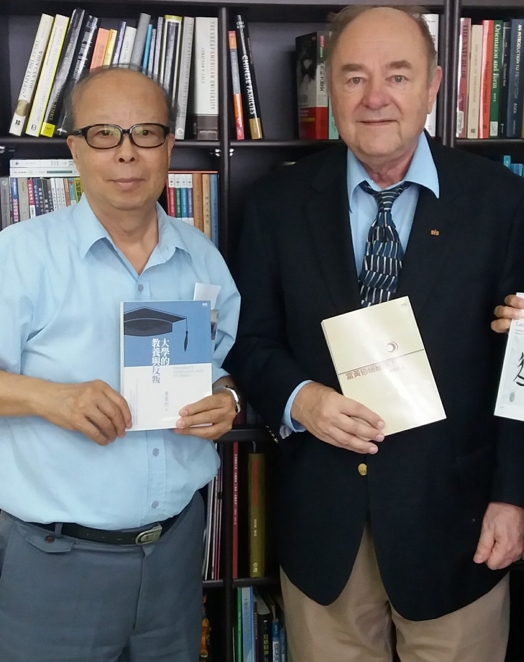

Slide 8
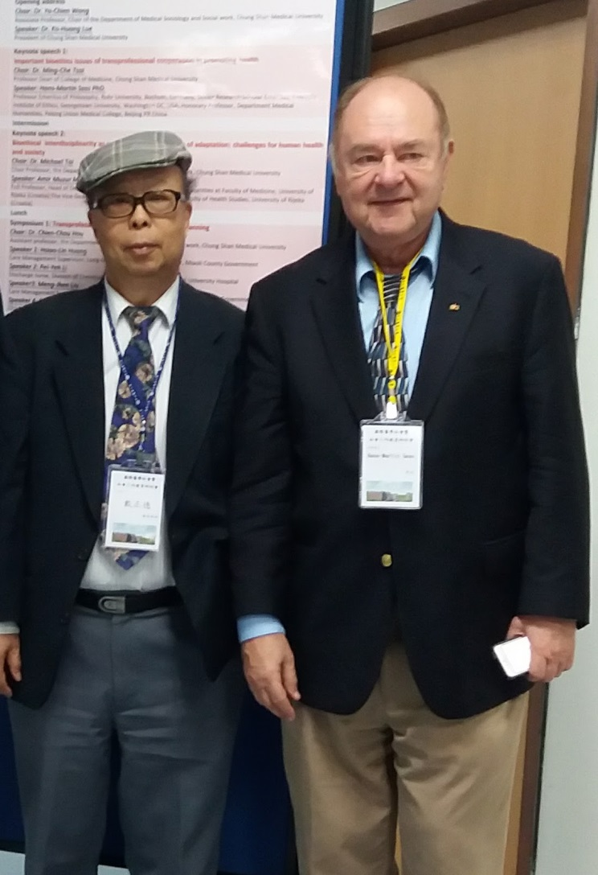

Slide 9
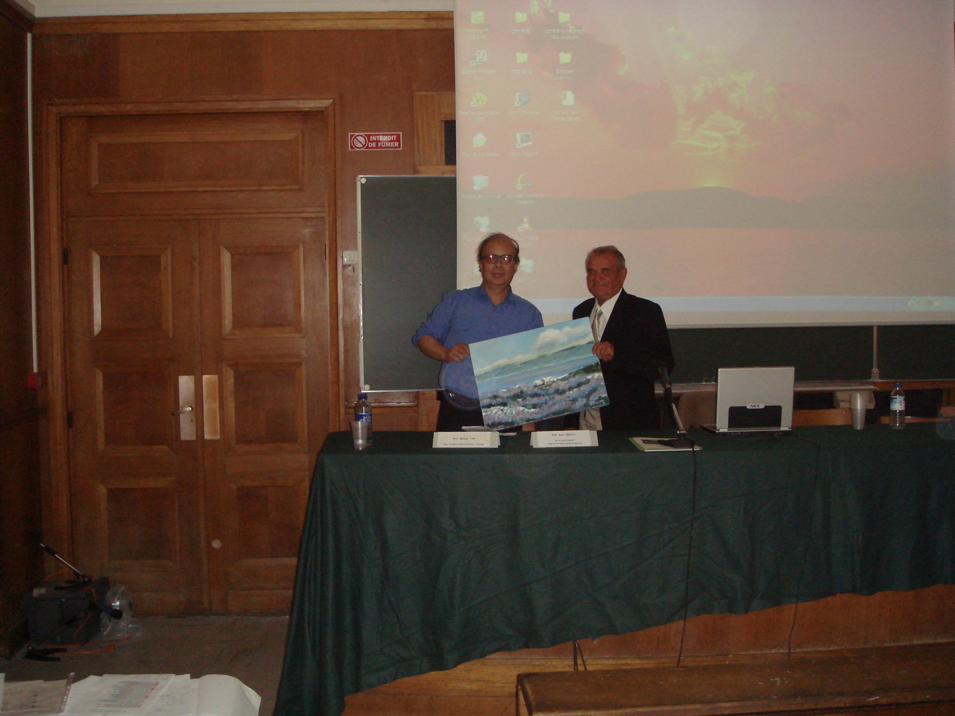

Slide 10
